Slide 1
Modified Onion Routing and its Proof of Concept
By: Gyanranjan Hazarika

Slide 2
The Goal is not to explain what is OR or TOR
Goal is to overcome some of the vulnerabilities of OR
Provide a proof of concept of the
proposed modifications

Slide 3
Vulnerabilities of OR
Secure Site
Initiator
host
No MAC
OP
X
U
Proxy/Router
controlled by
Secure Site
Link encrypted
between routing
nodes
Passive adversary can link sender & recipient
Y
EF
Unsecured socket
connection
Routing node
Responder’s
Proxy/Router
Responder
host

Slide 4
How do we overcome?
Secure Site
Initiator
host
Add MAC
Initiator Host
MIX
MIX
OP
X
U
Proxy/Router
controlled by
Secure Site
Link encrypted
between routing
nodes
MIX
Responder
host
Y
EF
Unsecured socket
connection
Routing node
Responder’s
Proxy/Router
Responder
host

Slide 5
Time to Provide Proof of Concept
Challenges?
Encryption is a big challenge!
We have link encryption, onion layer encryption and forward & backward encryption
D. Goldschlag et al[1] says use PKCS for onion layer encryption.
Nothing on link encryption

Slide 6
Use of DH Key
May be symmetric key is better in terms of computation
Used Diffie-Hellman secret for link encryption and onion layer encryption
Used 256 bit long secret key
A word on Diffie-Hellman exchange…..

Slide 7
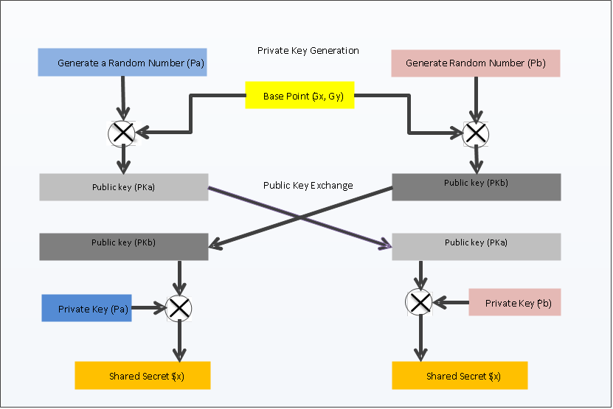
Diffie-Hellman Key Exchange
Not going to spend time on it. Perhaps, we all know……

Slide 8
More challenges
What about forward and backward cryption?
What about network layout? How members connect to each other?
Introduced ORCS. Onion Routing
Central Server. An idea borrowed
from Crowds!

Slide 9
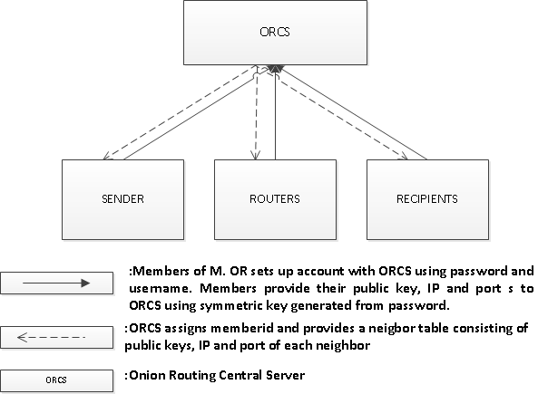
ORCS

Slide 10
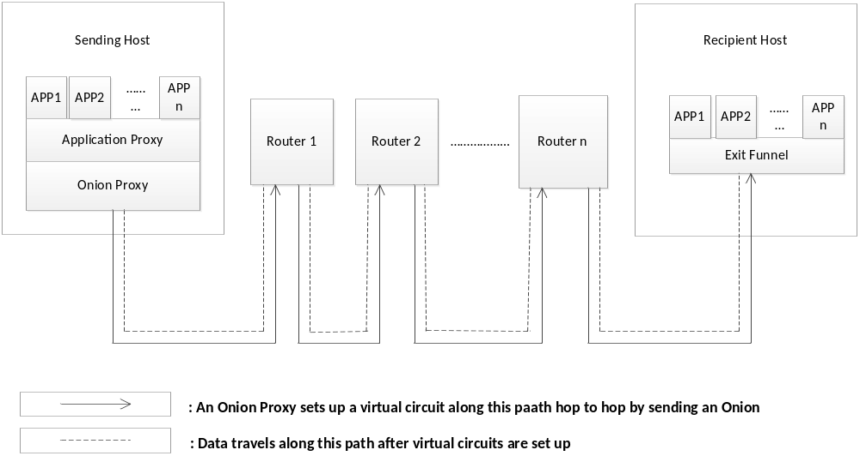
Base Architecture

Slide 11
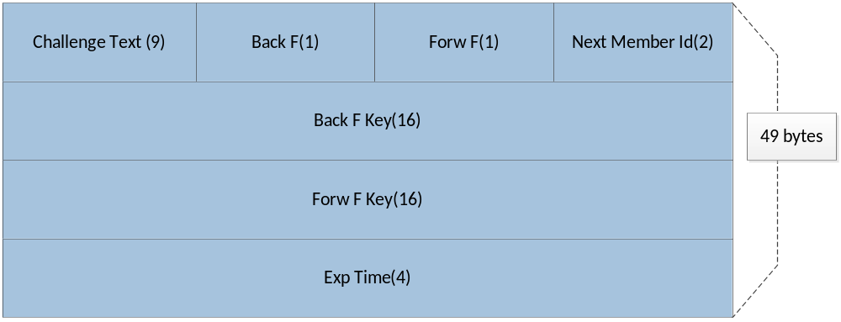
A Layer of an Onion In Packet Format

Slide 12
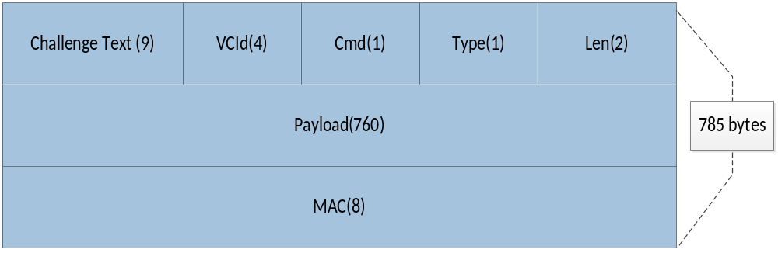
A Typical Packet
A Flaw in the packet format?

Slide 13
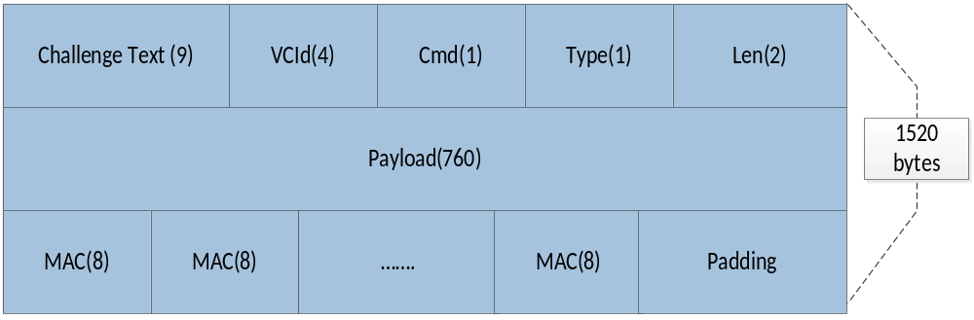
Proposed Packet Format

Slide 14
DEMO
Demo Part-1
Demo Part-2
We can make it work!

Slide 15
Some Results
No of sender's msg | Threshold pool mix (n[pool]-s[threshold]) | Avg No of Dummy msgs | No of trials
1 | (2-1) | 2.3 | 10 (3, 1, 1, 2, 3, 1, 2, 2, 6, 2)
2 | (2-1) | 3 | 5 (6, 3, 2, 3, 1)
1 | (3-1) | 4 | 10 (2, 3, 3, 12, 5, 0, 9, 4, 1, 1)
2 | (3-1) | 5 | 5(8, 17, 2, 5, 3)
1 | (3-2) | 6.4 | 10 (3, 7, 1, 15, 1, 1, 11, 7, 3, 15)
2 | (3-2) | 7 | 5(6, 10, 6, 4, 9)
Limited Testing Only!

Slide 16
Blending Attack Behavior
For performing blending attack the attacker needs to flush the pool and ensure that all the good messages are out. Till then he delays the target message.

Slide 17
Strong Protection against Blending Attack
With this design where OR and MIX blends together, it will be very difficult for an attacker to inject bad messages into the MIXes as he needs to at least have the (forward fn, Key) pair to form a bad message which is distinguishable when it comes out of the MIX. (forward fn, Key) pair is available with the sender and the MIX itself. So, unless the sender or the MIX itself is compromised attacker can't perform blending attack. The chances of the sender compromising its own anonymity is nil, otherwise, he would not have gone through the hurdle of a OR network. If MIX is compromised there is no need of blending attack. The link encryption will be an extra hurdle.

Slide 18
What if ORCS is compromised?
Only way ORCS can aid an adversary is by facilitating MITM
An authorization code will help preventing!
How to distribute the code?

Slide 19
A Word about the Source Code
It consists of 32 files and around 8200 LOC.
Plan to open source it after receiving feedback from the Professor. May have to incorporate comments.
Any suggestion is welcome!

Slide 20

References
[1] D. Goldschlag, M. Reed, and P. Syverson. Hiding routing information. In Ross Anderson, editor, Information Hiding, First International Workshop, pages 137-150. Springer-Verlag, LNCS 1174, May 1996.
[2] Michael K. Reiter and Aviel D. Rubin. Crowds: anonymity for web transactions. ACM Transactions on Information and System Security, 1(1):66-92, 1998.
[3] B. Schneier. Applied Cryptography: Protocols, Algorithms and Source Code in C, John Wiley and Sons, 1994.
[4] Paul F. Syverson, David M. Goldschlag, and Michael G. Reed, “Anonymous Connections and Onion Routing “, IEEE Journal on Selected Areas in Communication, Vol 16, No.4, pp 482-494, May 1998, Naval Research Laboratory. 1998
[5] Andrei Serjantov, Roger Dingledine, and Paul Syverson. From a trickle to a flood: Active attacks on several mix types. In Fabien Petitcolas, editor, Proceedings of Information Hiding Workshop (IH 2002). LNCS 2578, Springer, October 2002.

